Slide 1
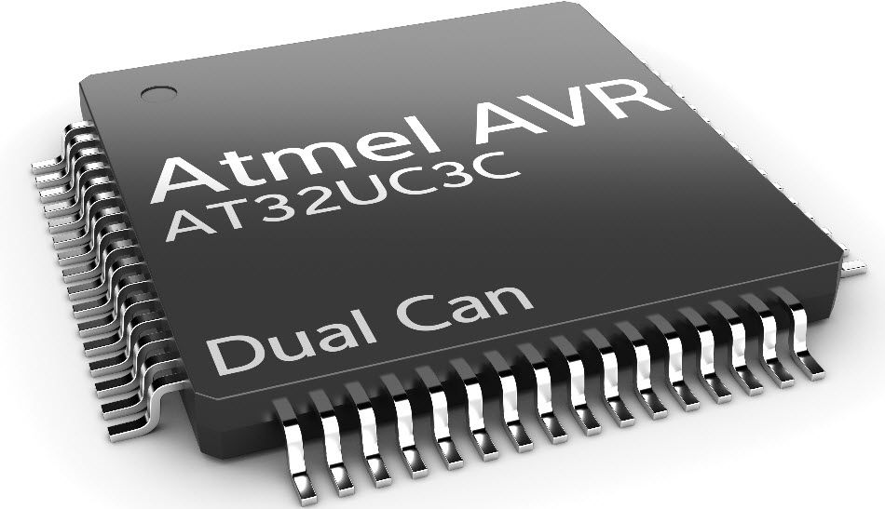
SKYLINE INSTITUTE OF ENGINEERING AND TECHNOLOGY GREATER NOIDA SEMINAR ON ATMEGA SERIES MICROCONTROLLER
PRESENTED BY:- MOHD MONISH PRESENTED TO:- Mr. PRADEEP KUMAR CHANDRA
ME(B2) 4TH YEAR MECHANICAL DEAPRTMENT

Slide 2
CONTENTS
HISTORY
INTRODUCTION
DEVICE OVERVIEW
BASIC FAMILY OF AVRs
PROGRAMMING INTERFACES
SOME DEVICE & DESCRIPTION
32-bit AVRs
PROGRAM MEMORY
MCU SPEED
FEATURES
APPLICATIONS

Slide 3
What is micro-controller?
A microcontroller (or MCU for microcontroller unit) is a small computer on a single integrated circuit.
A microcontroller contains one or more CPUs (processor cores) along with memory and programmable input/output peripherals.

Slide 4
What are the History of microcontroller?
The first microprocessor was the 4-bit Intel 4004 released in 1971, with the Intel 8008.
Gary Boone and Michael Cochran with the successful creation of the first microcontroller in 1971.
The result of their work was the TMS 1000, which became commercially available in 1974 (It combined read-only memory, read/write memory, processor and clock on one chip and was targeted at embedded systems).
Further changes occurs in 1977, 2002 (8-bit microcontrollers &microprocessor), 2006, 2010, 2011, 2012 , 2015.

Slide 5
INTRODUCTION
AVR is the family of microcontroller developed by Atmel in 1996.
These are modified Harvard architecture 8-bit RISC single chip microcontroller.
Presently there should a vast variety of Atmel series microcontroller for different types of purposes.
AVR was the one of the first microcontroller families to use on chip flash memory storage.
Basically AVR has no defined full form but it refers on the name of developer Alf and Vegard’s RISC.
The original AVR MCU was developed at a local ASIC house in Trondheim, Norway called Nordic VLSI at the time.

Slide 6
DEVICE OVERVIEW
The AVR is a modified Harvard architecture machine.
In AVR data are stored in separate physical memory system.
These include everything from general-purpose devices to models with specialized peripherals like
Peripheral Touch Controller (PTC)
USB
LCD controllers as well as CAN
LIN and Power Stage Controllers (PSC).

Slide 7
What are the parts of micro-controllers?
Central processing unit(CPU)
Random Access Memory)(RAM)
Read Only Memory(ROM)
Input/output ports
Timers and Counters
Interrupt Controls
Analog to digital converters
Digital analog converters
Serial interfacing ports
Oscillatory circuits

Slide 8
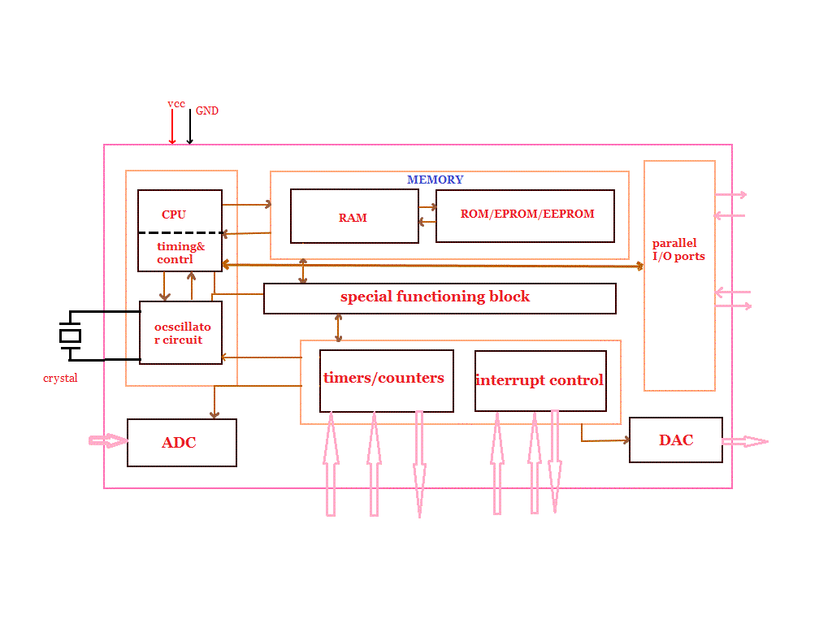
Layout of microcontroller?

Slide 9
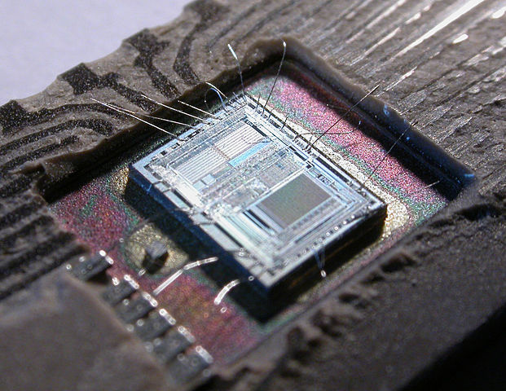
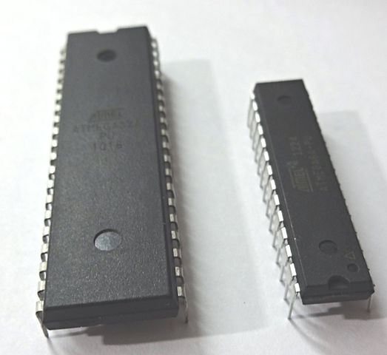
Amendments in microcontroller?
Differences in the microcontroller in 1971 to 2015

Slide 10
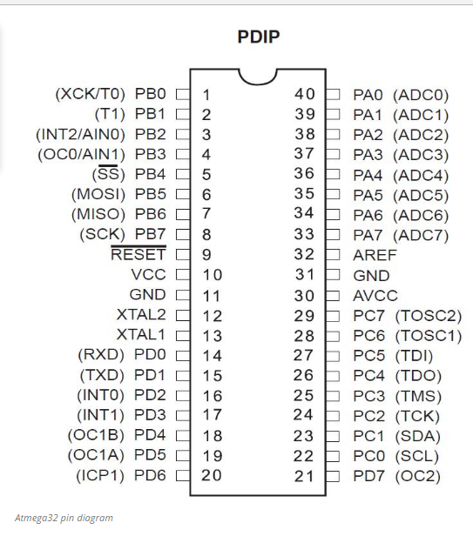
Plastic Dual In-Line Packages (PDIP) are long-established industry standard through-hole packages. PDIP Plastic Dual In-Line Package.

Slide 11
BASIC FAMILIES OF AVR
TINY AVR
0.5- 16KB Program memory
6–32-pin package
Limited peripheral set
megaAVR
4–256 KB program memory
28–100-pin package
XMEGA
16–384 KB program memory
32-pin package: XMEGA-E (XMEGA8E5)
FPSLIC (AVR with FPGA)
AVR core can run at up to 50 MHz
FPGA 5k to 40k gates

Slide 12
PROGRAMMING INTERFACES
ISP (IN SYSTEM PROGRAMMING)
PDI (PROGRAM AND DEBUG INTERFACE)
HSVP (HIGH VOLTAGE SERIAL PROGRAMMING)
HVPP (HIGH VOLTAGE PARALLEL PROGRAMMING)(it is considered the "final resort" and may be the only way to correct bad fuse settings on an AVR chip)
BOOTLOADER
ROM (The AT90SC series of AVRs are available with a factory mask-ROM rather than flash for program memory)
aWIRE (new one-wire debug interface available on the new UC3L AVR32 devices)

Slide 13
SOME DEVICE & DESCRIPTION
DEVICE
DESCRIPTION
ATmega48
ATmega8
ATmega16
ATmega32
ATmega325
ATmega325P
ATmega16A
8-bit AVR Microcontroller, 4KB Flash, 28/32-pin.
8-bit AVR Microcontroller, 8KB Flash, 28/32-pin.
8-bit AVR Microcontroller, 16KB Flash, 40/44-pin.
8-bit AVR Microcontroller, 32KB Flash, 40/44-pin.
8-bit AVR Microcontroller, 32KB Flash, 64-pin.
8-bit picoPower AVR Microcontroller, 32KB Flash, 64-pin.
8-bit AVR Microcontroller, 16KB Flash, 40/44-pin

Slide 14
32- bit AVRs
In 2006, Atmel released microcontrollers based on the 32-bit AVR32 architecture.
This is a completely different architecture unrelated to the 8-bit AVR, intended to compete with the ARM-based processors.
It has a 32-bit data path, SIMD and DSP instructions, along with other audio- and video-processing features.
The instruction set is similar to other RISC cores, but it is not compatible with the original AVR (nor any of the various ARM cores).

Slide 15
PROGRAM MEMORY
Program instructions are stored in non-volatile flash memory.
Although the MCUs are 8-bit, each instruction takes one or two 16-bit words.
The size of the program memory is usually indicated in the naming of the device itself.
There is no provision for off-chip program memory; all code executed by the AVR core must reside in the on-chip flash.

Slide 16
MCU SPEED
The AVR line can normally support clock speeds from 0 to 20 MHz, with some devices reaching 32 MHz.
Lower-powered operation usually requires a reduced clock speed.
All recent (Tiny, Mega, and Xmega, but not 90S) AVRs feature an on-chip oscillator, removing the need for external clocks or resonator circuitry.
Some AVRs also have a system clock prescaler that can divide down the system clock by up to 1024.
This prescaler can be reconfigured by software during run-time, allowing the clock speed to be optimized.

Slide 17
SPECIAL FEATURES
Multifunction, bi-directional general-purpose I/O ports with configurable, built-in pull-up resistors.
Multiple internal oscillators, including RC oscillator without external parts.
Internal data EEPROM up to 4 KB.
Internal SRAM up to 16 KB (32 KB on Xmega).
Analog comparator
10 or 12-bit A/D converters, with multiplex of up to 16 channels.
Multiple power-saving sleep modes
LCD controller support
DMA controllers and "event system" peripheral communication.

Slide 18
APPLICATIONS
Requiring large amount of codes.
Data memories with performance up to 20MIPS (MIPS is a reduced instruction set computer (RISC)).
Minimize power consumption of device.
All megaAVR devices offer self- programmability for fast, secure, cost-effective in circuit upgrades.
All these devices are supported by the Atmel Studio development platform.

Slide 19
BIBLIOGRAPHY
http://www.atmel.com/products/microcontrollers/avr/megaavr.aspx.
W. BOLTON (REFERENCE BOOK).
http://www.circuitstoday.com/atmega32-avr-microcontroller-an-introduction.

Slide 20
THANKS

